Slide 1
University of Diyala
College of Engineering
Department of Communications Engineering
Satellite Communications
By:
Dr. Majidah Hameed Majeed

Slide 2
Lecture # 9

Slide 3
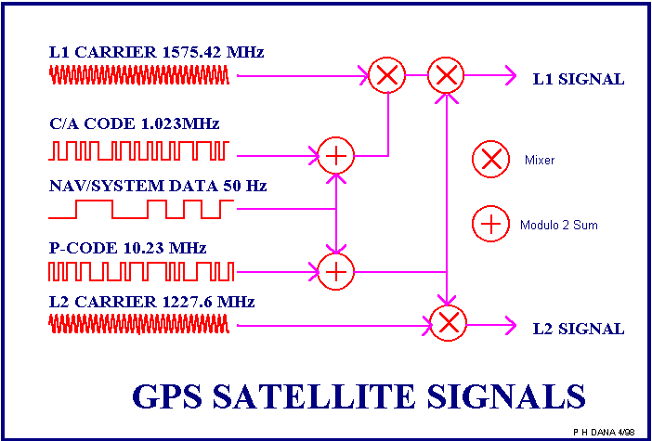
4.5 GPS SATELLITE SIGNAL STRUCTURE
The GPS transmit two microwave carrier signals. The L1 frequency (1575.42 MHz)
carries the navigation message and the code signals. The L2 frequency (1227.60 MHz) is used to measure the ionospheric delay Fig(4.6) shows the GPS s transmit two
microwave carrier signals.
Fig (4.6)
Three binary codes shift the L1 and/or L2 carrier phase are :-
The C/A Code (Coarse Acquisition) modulates the L1 carrier phase. The C/A code is a repeating 1 MHz Pseudo Random Noise (PRN) Code. This noise-like code modulates the L1 carrier signal, "spreading" the spectrum over a 1 MHz bandwidth. The C/A code repeats every 1023 bits (one millisecond). There is a different C/A code PRN for each GPS satellite . GPS satellites are often identified by their PRN number, the unique identifier for each pseudo-random-noise code. The C/A code that modulates the L1 carrier is the basis for the civil application.

Slide 4
The P-Code (Precise) modulates both the L1 and L2 carrier phases. The P-Code is a very long (seven days) 10 MHz PRN code. In the Anti-Spoofing (AS) mode of operation, the P-Code is encrypted into the Y-Code. The encrypted Y-Code requires a classified AS Module for each receiver channel and is for use only by authorized users with cryptographic keys.
The Navigation Message also modulates the L1-C/A code signal. The Navigation Message is a 50 Hz signal consisting of data bits that describe the GPS satellite orbits, clock corrections, and other system parameters.
The atomic clocks aboard the GPS satellites produce a fundamental
10.23 Mhz.
frequency �₀=
Two frequencies are derived from it: L1(fo x154)and L2(fo x120):
– L1: 1.57542 GHz,
– L2: 1.22760 GHz,
  L1 and L2 are the two carrier frequencies used to transmit timing information by the GPS satellite.
  The information transmitted by the satellite is coded as a phase modulation of the carrier frequency
The satellite signals basically consists of Fig.(4.7) The two L-band carrier waves.
The ranging codes modulated on the carrier waves.
The Navigation Message.

Slide 5
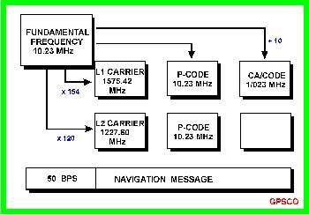
Fig(4.7) GPS satellite signal components.
For briefly each satellite transmits its own unique code: Two frequencies used
L1 Carrier 1575.42 MHz
L2 Carrier 1227.60 MHz
Codes
CA Code use L1 (civilian code)
P (Y) Code use L1 & L2 (military code)
P-code rate is the fundamental frequency (provides the basis for all others)

Slide 6
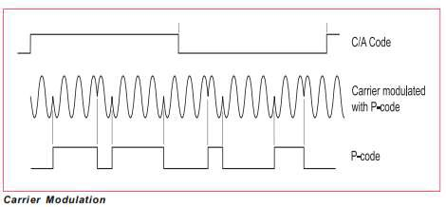
■ P-Code (10.23 MHz) /10 = 1.023 MHz (C/A code)
■ P-Code (10.23 MHz) X 154 = 1575.42 MHz (L1).
■ P-Code (10.23 MHz) X 120 = 1227.60 MHz (L2).
Navigation Message
In order to solve the user position equations, one must know where the SV is. The navigation and time code provides this
50 Hz signal modulated on L1 and L2
Fig (4.8)
4.6 What's the GPS signal?
A GPS signal contains three different bits of information — a pseudorandom code, ephemeris data and almanac data. The pseudorandom code is simply an I.D. code that identifies which satellite is transmitting information.
Ephemeris data tells the GPS receiver where each GPS satellite should be at any time throughout the day.
Each satellite transmits ephemeris data showing the orbital information for that satellite and for every other satellite in the system, as shown in fig (4.9).

Slide 7
Almanac data, which is constantly transmitted by each satellite, contains important information about the status of the satellite (healthy or unhealthy), current date and time. This part of the signal is essential for determining a position.
4.7 GPS, How it Works
Here's how GPS works in five steps:
The basis of GPS is "triangulation" from satellites.
To "triangulate," a GPS receiver measures distance using the travel time of radio signals.
To measure travel time, GPS needs very accurate timing.
Along with distance, you need to know exactly where the satellites are in space.
Finally you must correct for any delays the signal experiences as it travels through the atmosphere. You must also correct for the clock differences between the GPS receiver and the satellites.
4.7.1 Calculating the distance to the satellite
The whole idea behind GPS is to use satellites in space as reference points for locating positions here on earth. Our distance from the satellite is measured by calculating the time it takes for a radio wave to travel from the satellite to our GPS receiver. We multiply this time by the speed of light to get our distance.
Distance = Velocity x Time
Because radio waves travel at 300 million meters a second, the clocks used to measure the travel time must be extremely accurate , from fig ( 4.9)
10

Slide 8
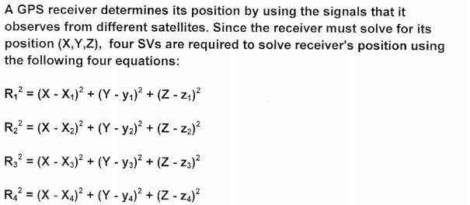
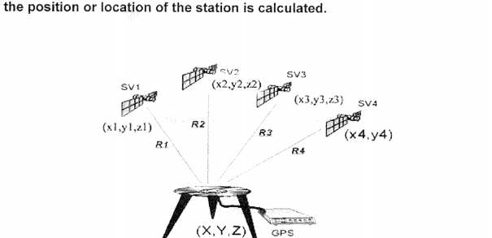
Fig ( 4. 9). hence solving the four equations for four unknowns
X,Y,Z
Fig (4.9)
For one satellite, the distance (R1) of a GPS unit is equal to the time its takes the radio signal to travel between the two, multiplied by the speed of the radio signal (the speed
of light). The time of the signal is determined by measuring the difference between the
same parts of the coded signals, the set of all points where our GPS receiver could be

Slide 9
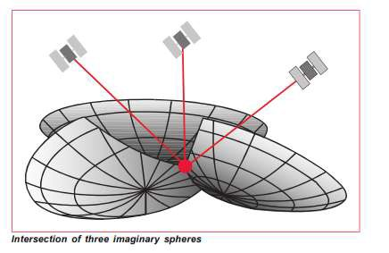
at that distance (R1) can now be represented as the surface of a sphere in the second figure below.
If we measure our distance to a second satellite and find out that it is (R2) meters away. That tells us that we're not only on the first sphere but we're also on a sphere at its respective distance from the second satellite. Or in other words, we're somewhere on the circle where these two spheres intersect. This intersection is the circle as seen in Figure 4.10.
If we make another measurement to a third satellite at distance (R3), this narrows our possible positions down to two points shown in Figure 4.10 So by ranging from three
satellites we have narrowed our position down to two points in space.
To decide which of these two points is our true location we could make a measurement from a fourth satellite.
R1
R2
R3
Fig (4.10)
From fig (4.9) , Satellite 1, S1, your device (GPS unit) measures your distance from the satellite to be R1 away, then you can only localize yourself on a circle

Slide 10
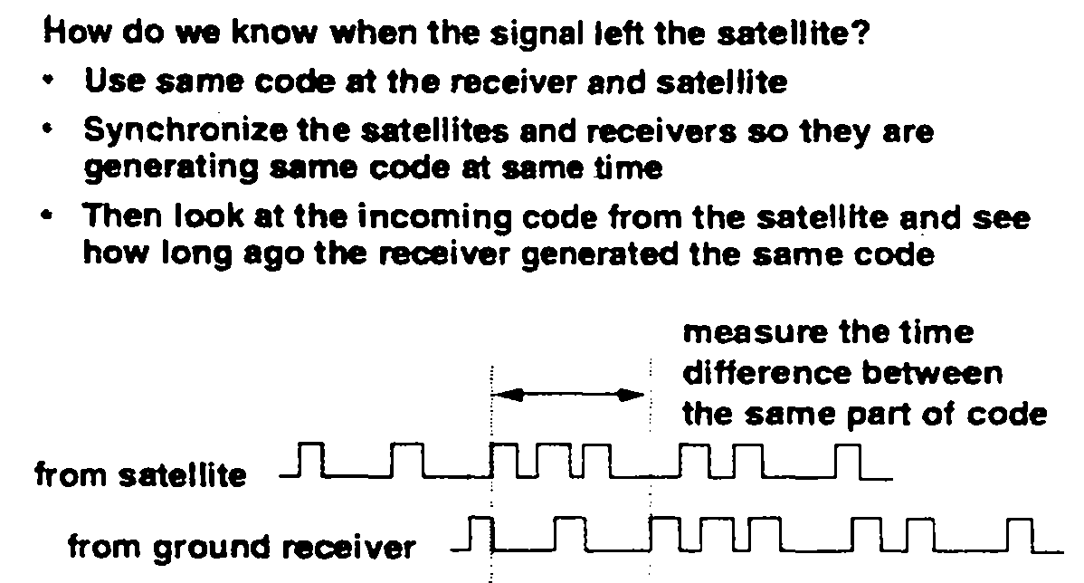
on the earth that is the locus of all points R1 from S1 Now from Satellite 2( S2) your GPS unit measures your distance from the satellite to be R2 away. Now you are localized to be on the intersection of the spheres centered at the satellites and of the respective radii. The intersection of the spheres is a circle. Next,
obtaining the distance from a third satellite (S3) allows us to locate in the
intersection of the three spheres and this intersection is two points . the fourth satellites. If we know the transit time of a signal and propagation of the signal, then we can determine the distance or range.
4.7.2 Calculating the Time
and so on to the speed of
Assuming we have the distances from four satellites and we know( xi,yi,zi ) , 1,2,3,4 are the exact positions of the satellites,
i =

Slide 11
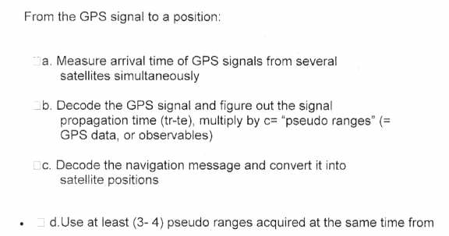
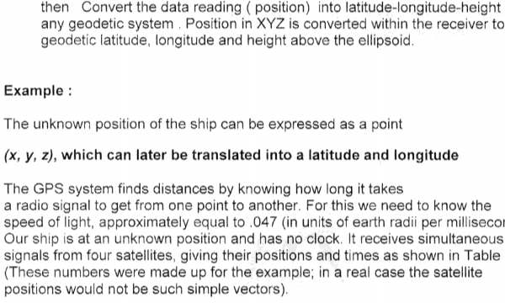
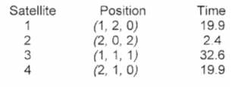
( 3-4 ) different satellites to compute the position as shown in fig ( 4.9)

Slide 12
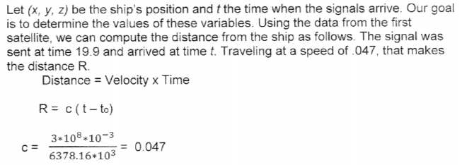
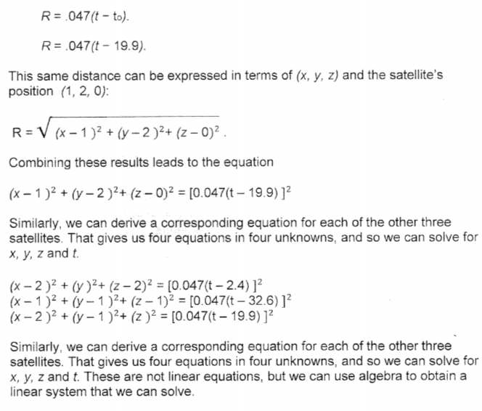
Solution :

